Slide 1

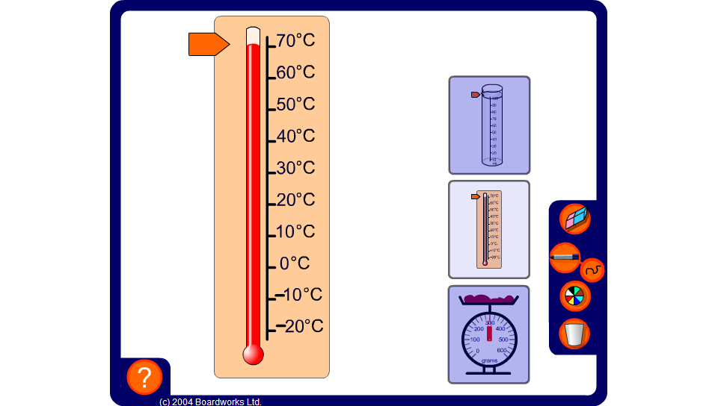


Reading scales
Notes:
Drag the pointer to various positions on the scales and ask pupils to read off the values. Use the pen tool to mark the scales as necessary.

